Slide 1
HVAC System
For heating, ventilation and air conditioning system

Slide 2
UML CRC Diagram

Slide 3
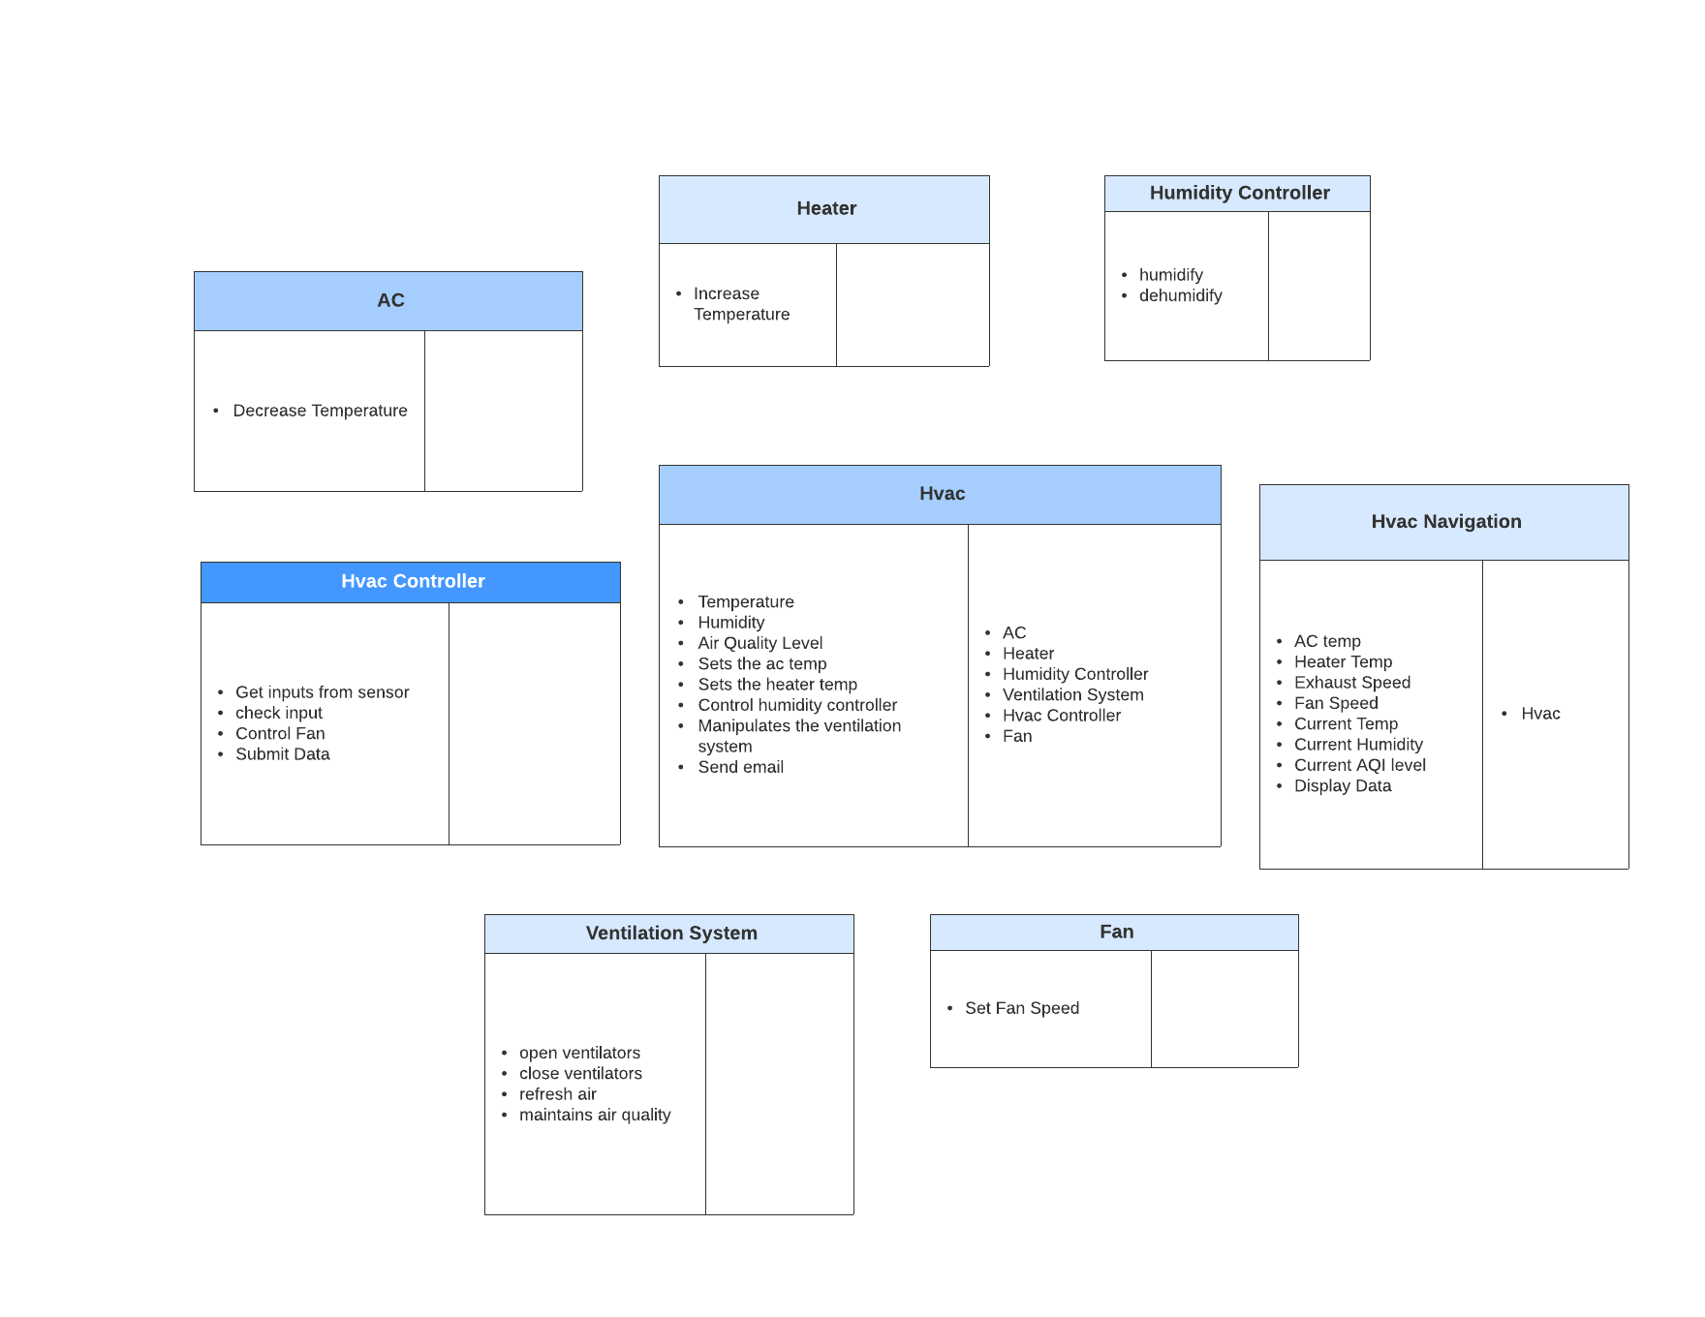

Slide 4
UML Use Case Diagram

Slide 5
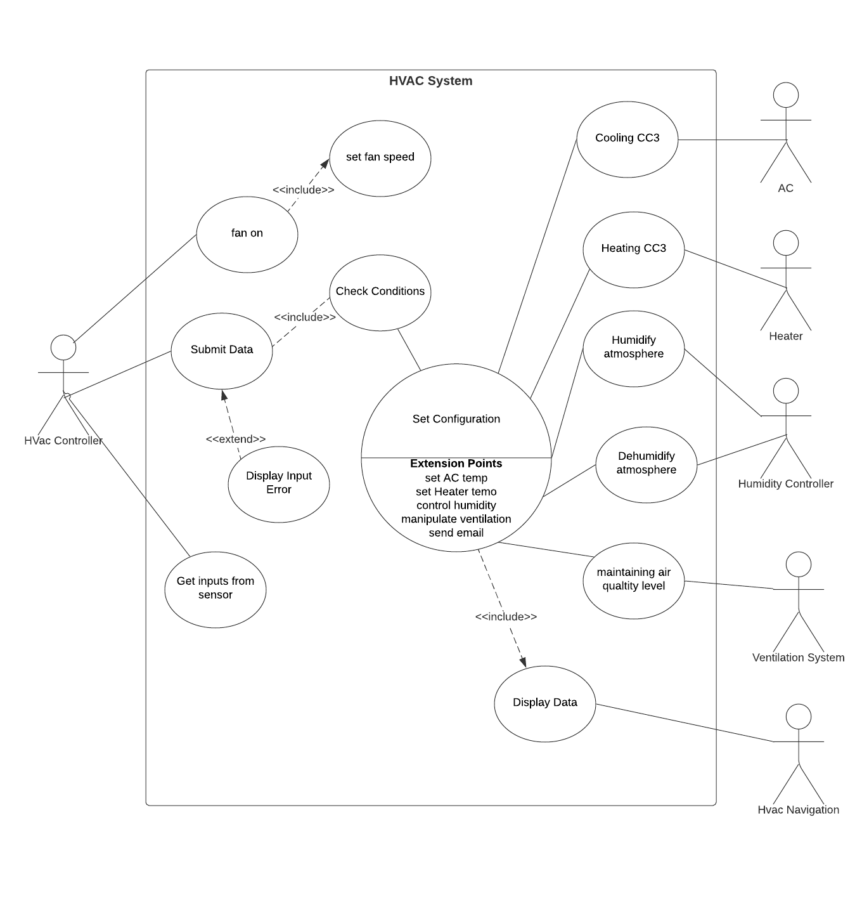

Slide 6
Thank You
IIT2019121 IIT2019140 IIT2019181 IIT2019182
Gurmeet Sagar Prathamesh Ekansh

